Slide 1
Gene regulation and genome evolution in Wolbachia pipientis
Preston Basting

Slide 2
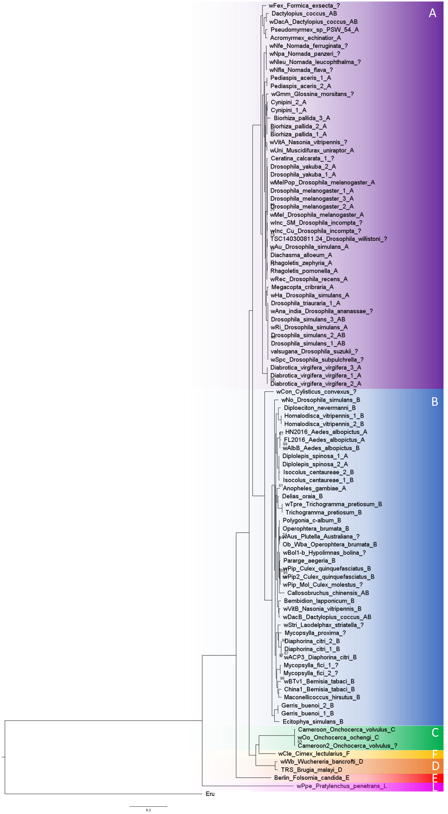
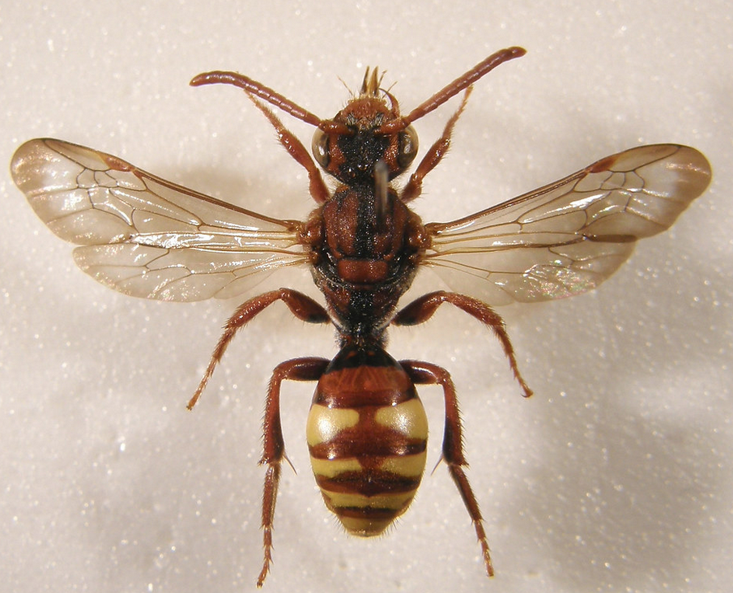
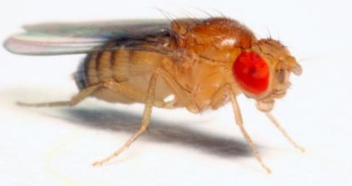
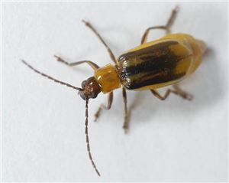
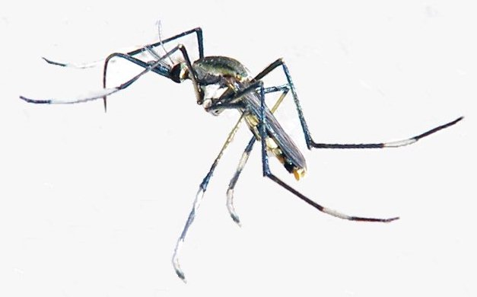
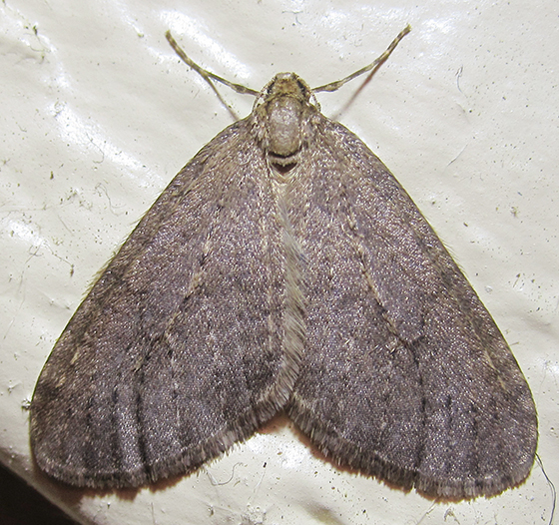
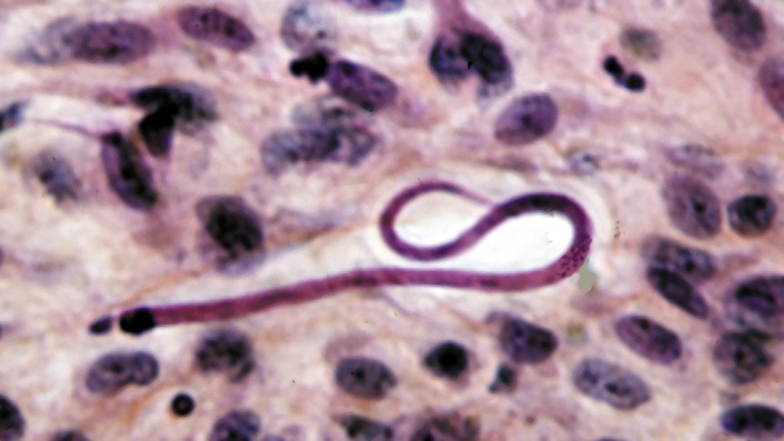
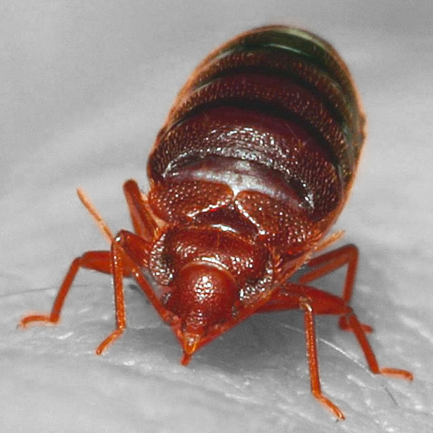
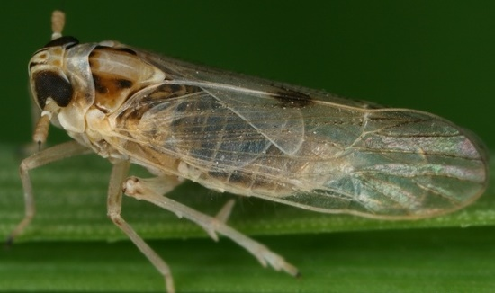
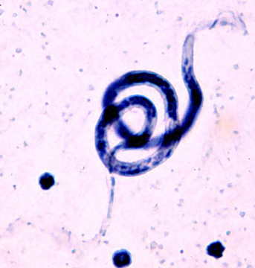
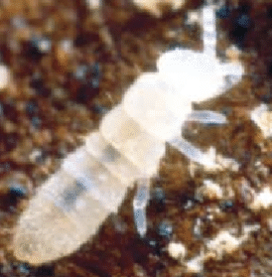
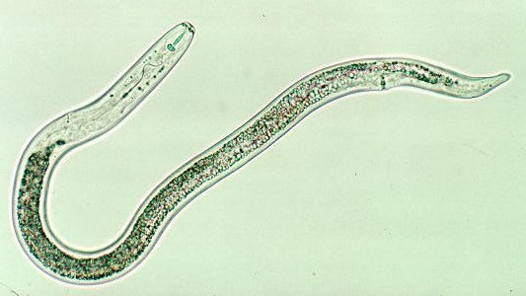
Wolbachia
Bacterial endosymbionts
Infects Arthropods and Nematodes
Reproductive parasites in Arthropods, obligate mutualists in Nematodes
Diverse range of hosts
Strains divided into Supergroups based on phylogeny
Wolbachia phylogeny discordant with Host phylogeny
Implies horizontal transmission of Wolbachia occurs
Notes:
Outgroup – Ehrlichia ruminantium (alphaproteobacterial, Family : Rickettsiaceae)

Slide 3
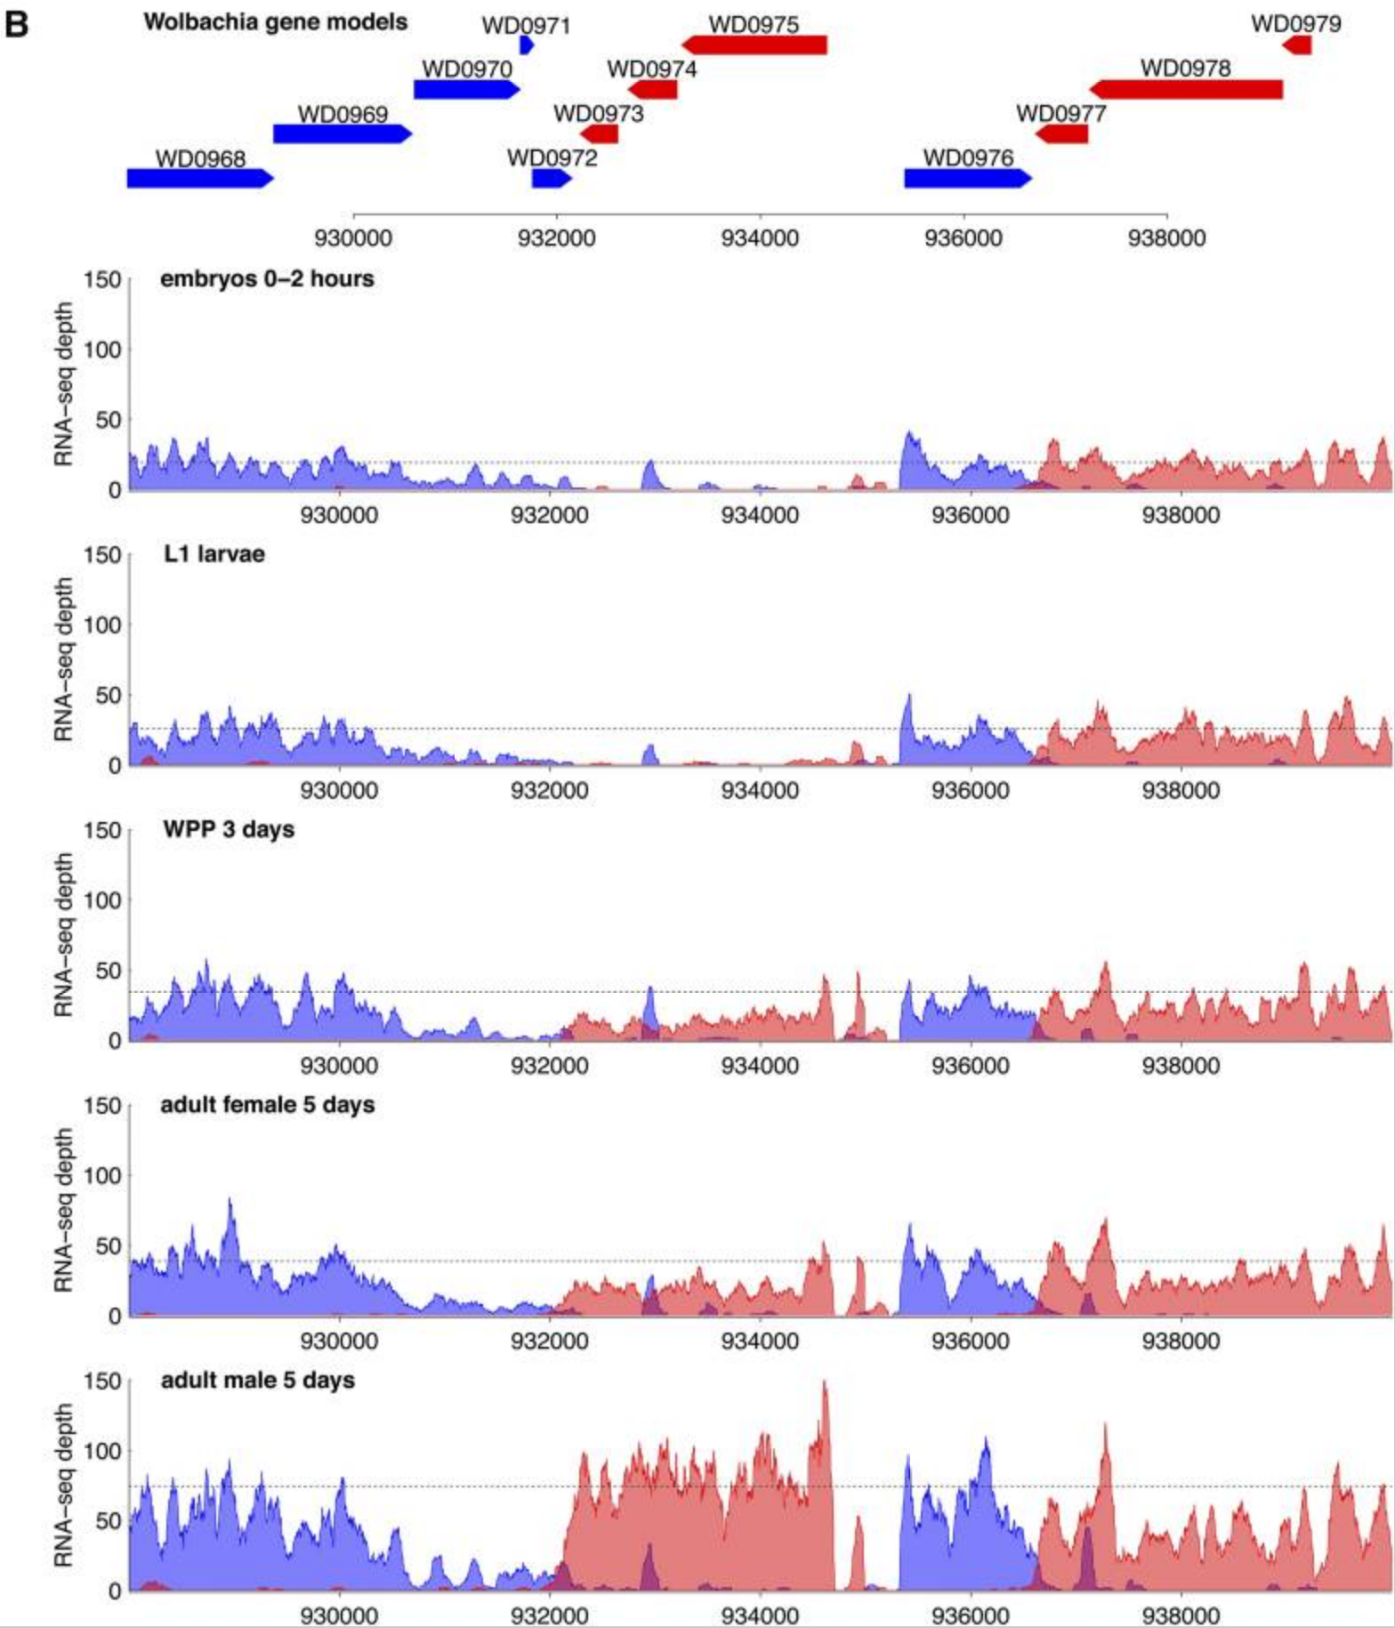
Wolbachia
Model for study of microbe-host interactions and coevolution
Induce wide variety of host phenotypes (reproductive parasitism, viral resistance)
Dynamic gene expression in different host life cycle stages
Little is known about Wolbachia gene regulation
Few transcriptional regulators
Gutzwiller, 2015
Notes:
6 transcriptional regulators
Suggests other transcriptional control mechanisms are active (small nc RNAs)

Slide 4
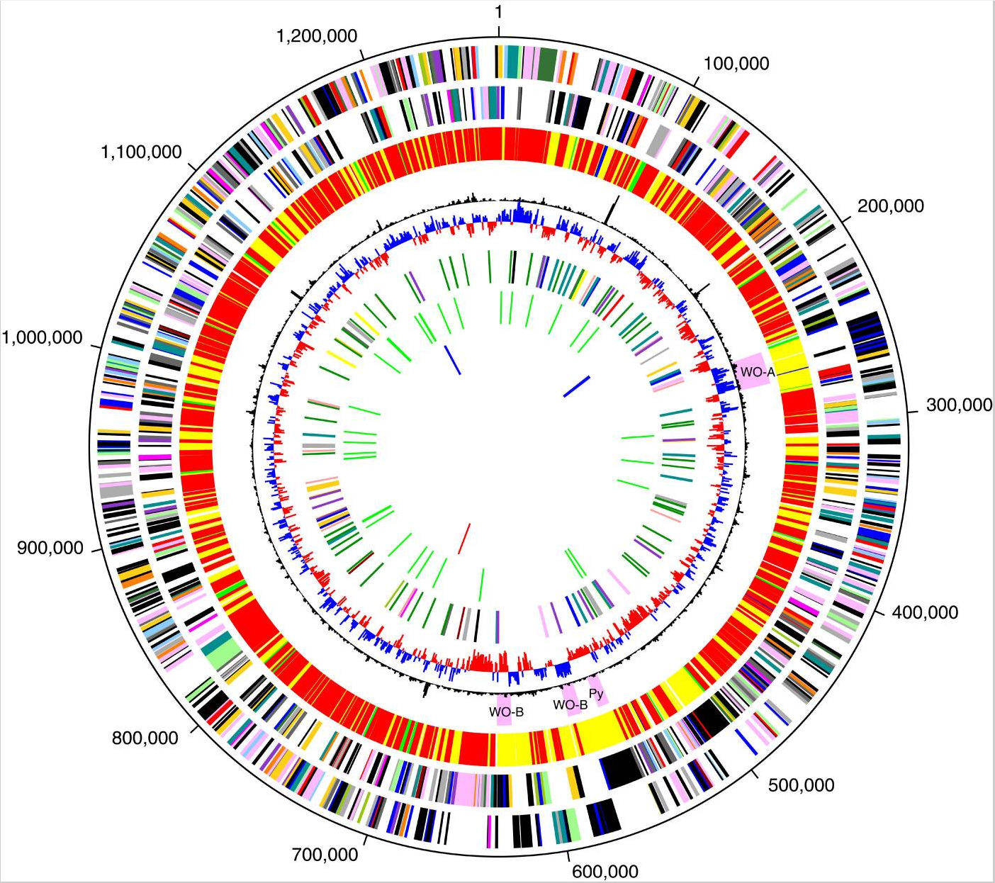
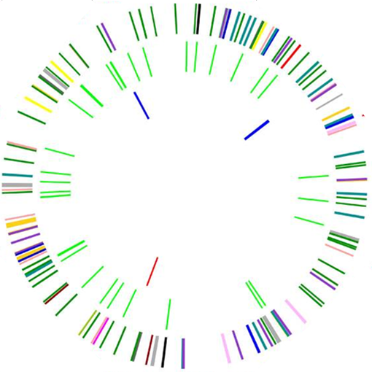
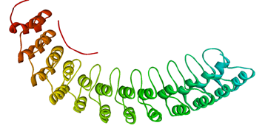
Wolbachia genomes are abundant in repeats
Wolbachia have significantly reduced genomes (1.08-1.7 Mb)
Despite reduction, repeats are highly prevalent
Particularly in Arthropod-infecting strains (wMel:14%, wRi:22%) vs (wBm:5.4%)
IS Elements
Group II Introns
Also abundant in genes containing Ankyrin repeats
Tandem ~33 amino-acid motif
Mediates protein-protein interactions
Rare in bacteria
wMel Repeats
(>200bp)
(Wu, 2004)
Notes:
Ankyrin repeats
Possibly excreted by Type IV secretion system
In Anaplasma phagocytophilum – secreted into host cell where it binds to host chromatin regulating host gene expression
Group II introns = class of mobile genetic elements
Group II introns consist of a 5’ and 3’ exon with an intron between
Intron contains ORF that encodes IntronEncodedProtein (IEP) – Reverse transcriptase and maturase
IEP binds intron and facilitates splicing
IEP + intron can then insert into target sites identical to splice site

Slide 5
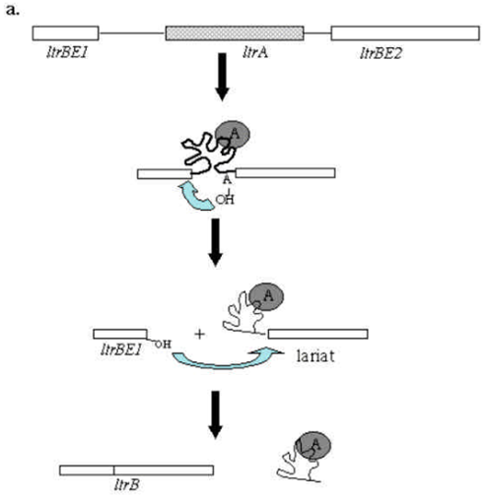
Group II introns
Notes:
Group II introns consist of a 5’ and 3’ exon with an intron between
Intron contains ORF that encodes IntronEncodedProtein (IEP) – Reverse transcriptase and maturase
IEP binds intron and facilitates splicing
IEP + intron can then insert into target sites identical to splice site

Slide 6
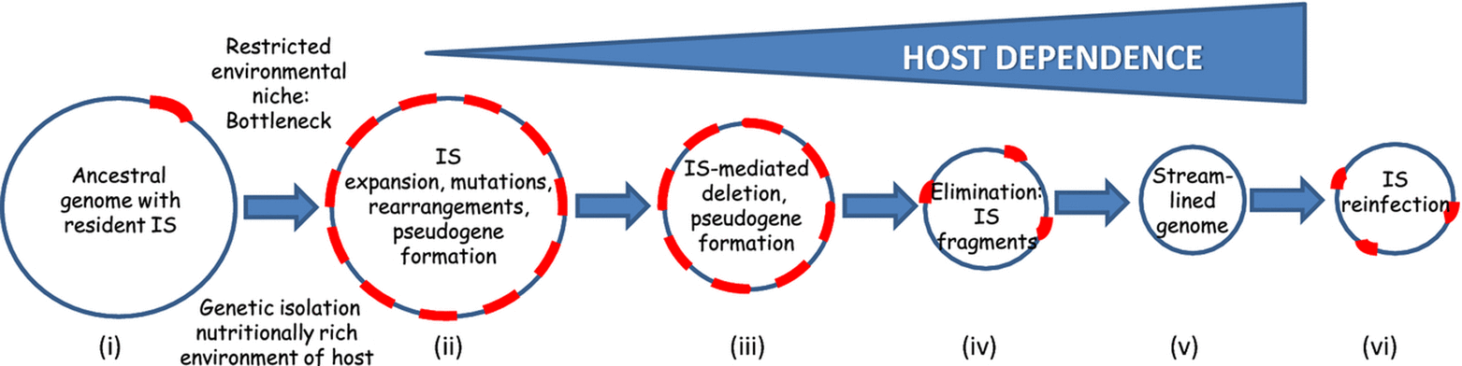
Wolbachia genomes are abundant in repeats
Wolbachia have significantly reduced genomes (1.08-1.7 Mb)
Despite reduction, repeats are highly prevalent
Particularly in Arthropod-infecting strains (wMel:14%, wRi:22%) vs (wBm:5.4%)
IS Elements
Group II Introns
Also abundant in genes containing Ankyrin repeats
Tandem ~33 amino-acid motif
Mediates protein-protein interactions
Rare in bacteria
wMel Repeats
(>200bp)
(Siguier, 2014)
(Wu, 2004)
Notes:
Group II introns consist of a 5’ and 3’ exon with an intron between
Intron contains ORF that encodes IntronEncodedProtein (IEP) – Reverse transcriptase and maturase
IEP binds intron and facilitates splicing
IEP + intron can then insert into target sites identical to splice site

Slide 7
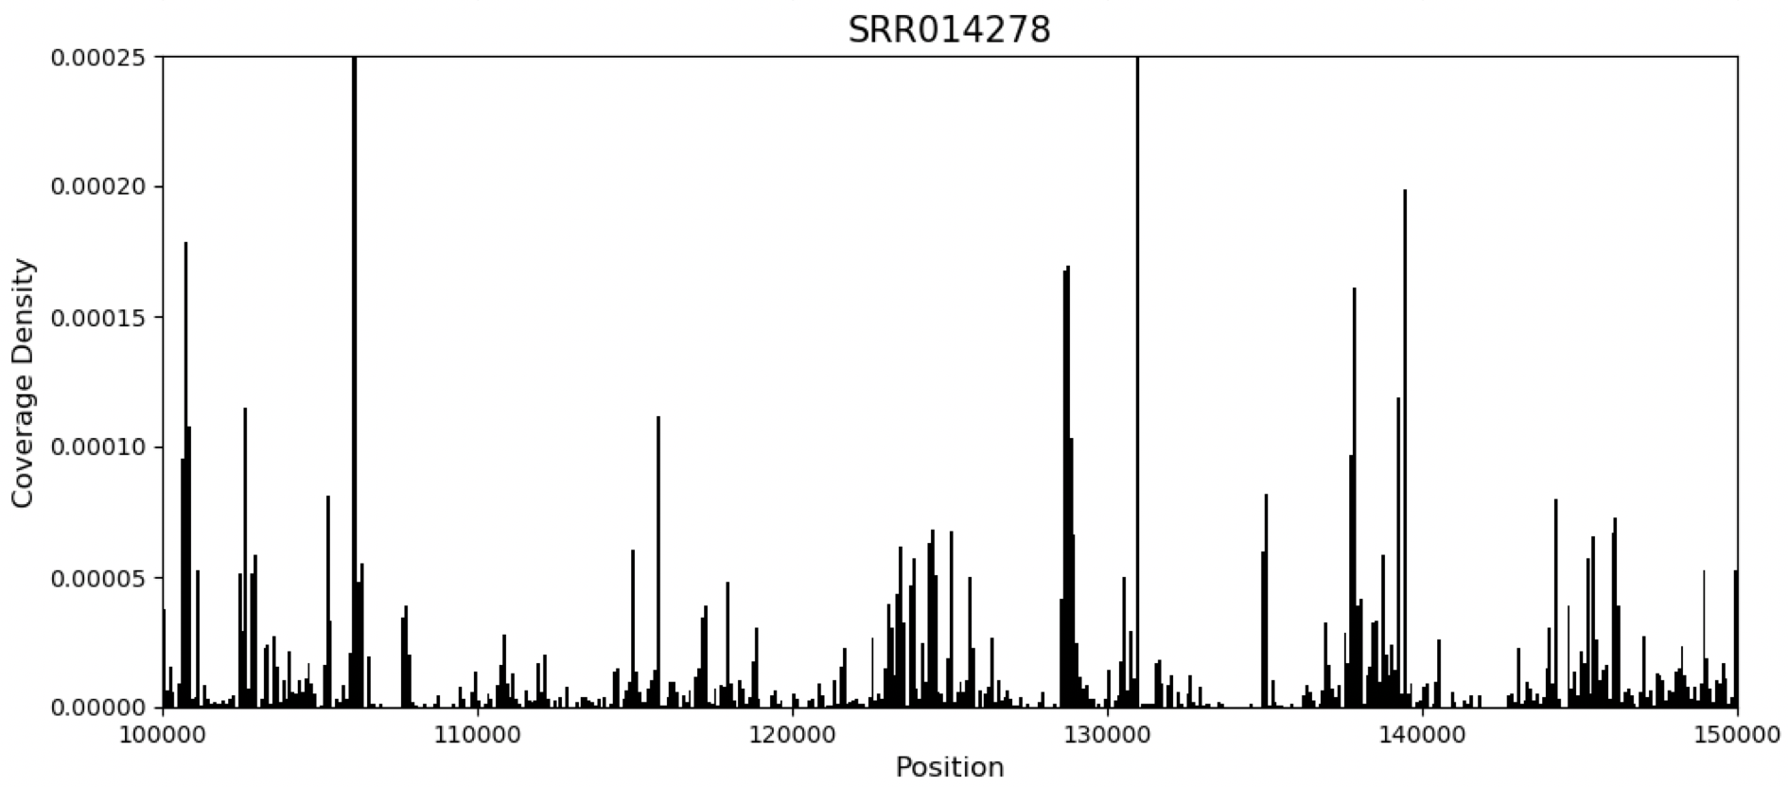
Excellent genomic resources available
Currently 22 complete genome assemblies from diverse strains in NCBI
Extensive data from infected Drosophila melanogaster
DNAseq – Hundreds of wMel-infected samples from previous studies (Richardson et al. 2012, Early 2013)
RNAseq – wMel expression across 30 time points of D. melanogaster life cycle (modENCODE, Gutzwiller, 2015)
Short RNAseq (18-29nt) – produced frequently in siRNA and piRNA pathway studies (Czech, 2013)
wMel-infected samples show an overabundance of reads mapping to the wMel genome
Notes:
Richardson 179/290 infected
Early 91
Some evidence of sncRNAs in Wolbachia
- Mayoral et al. 2014, 2 ~30bp sRNAs
- Woolfit, experimentally verified 1 292bp small RNA.

Slide 8
Aims
Validate and improve Wolbachia operon predictions
Explore patterns in Wolbachia repetitive DNA evolution
Determine the biological significance of short RNAs in Wolbachia

Slide 9
Operon Prediction
Much of the Wolbachia genes lack functional annotations
Genes of the same operon tend to share similar function, pathway, and/or interact (Salgado, 1999)
Reliable Wolbachia operon predictions would aid in identifying functions of uncharacterized genes
Notes:
433/1195 hypothetical proteins in wMel
Help model regulatory networks

Slide 10
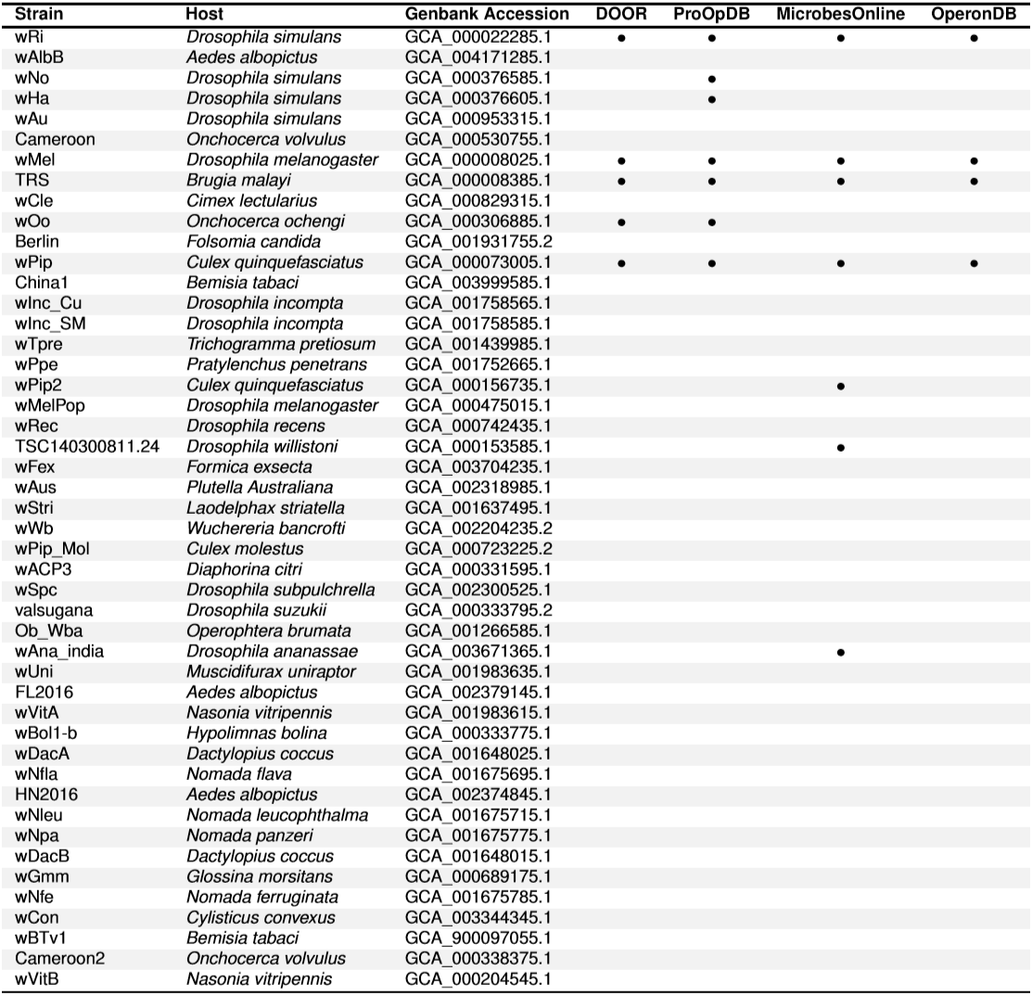
Wolbachia Poorly represented in Operon DBs
Matching Operon predictions for wMel
 | DOOR | ProOp | Microbes | OperonDB
DOOR | 232 | 178 | 180 | 18
ProOp | 178 | 250 | 200 | 18
Microbes | 191 | 200 | 276 | 21
OperonDB | 18 | 18 | 21 | 139
Notes:
DOOR – Intergenic distance, neighborhood conservation, phylogenetic distance (co-presence/co-absence from genomes), inter-operonic motifs, similarity scores between GO terms of gene pairs, length ratio between pair of genes (Decision tree)
ProOpDB – Uses STRING scores and intergenic distance in neural network
STRING – probability scores generated based upon conserved neighborhoods, gene fusions, cooccurance, coexpression, experimentally derived protein-protein interactions, co-expression, text mining, KEGG database metabolic maps
MicrobesOnline – intergenic distance, neighborhood conservation, expression pattern, similar GO category, similar COG functional category (Naïve Bayes)
OperonDB – conservation of gene order and gene orientation (own algorithm and probability function)
DOOR v ProOpDB = 77%
DOOR v MicrobesOnline = 82%
DOOR v OperonDB = 8%

Slide 11
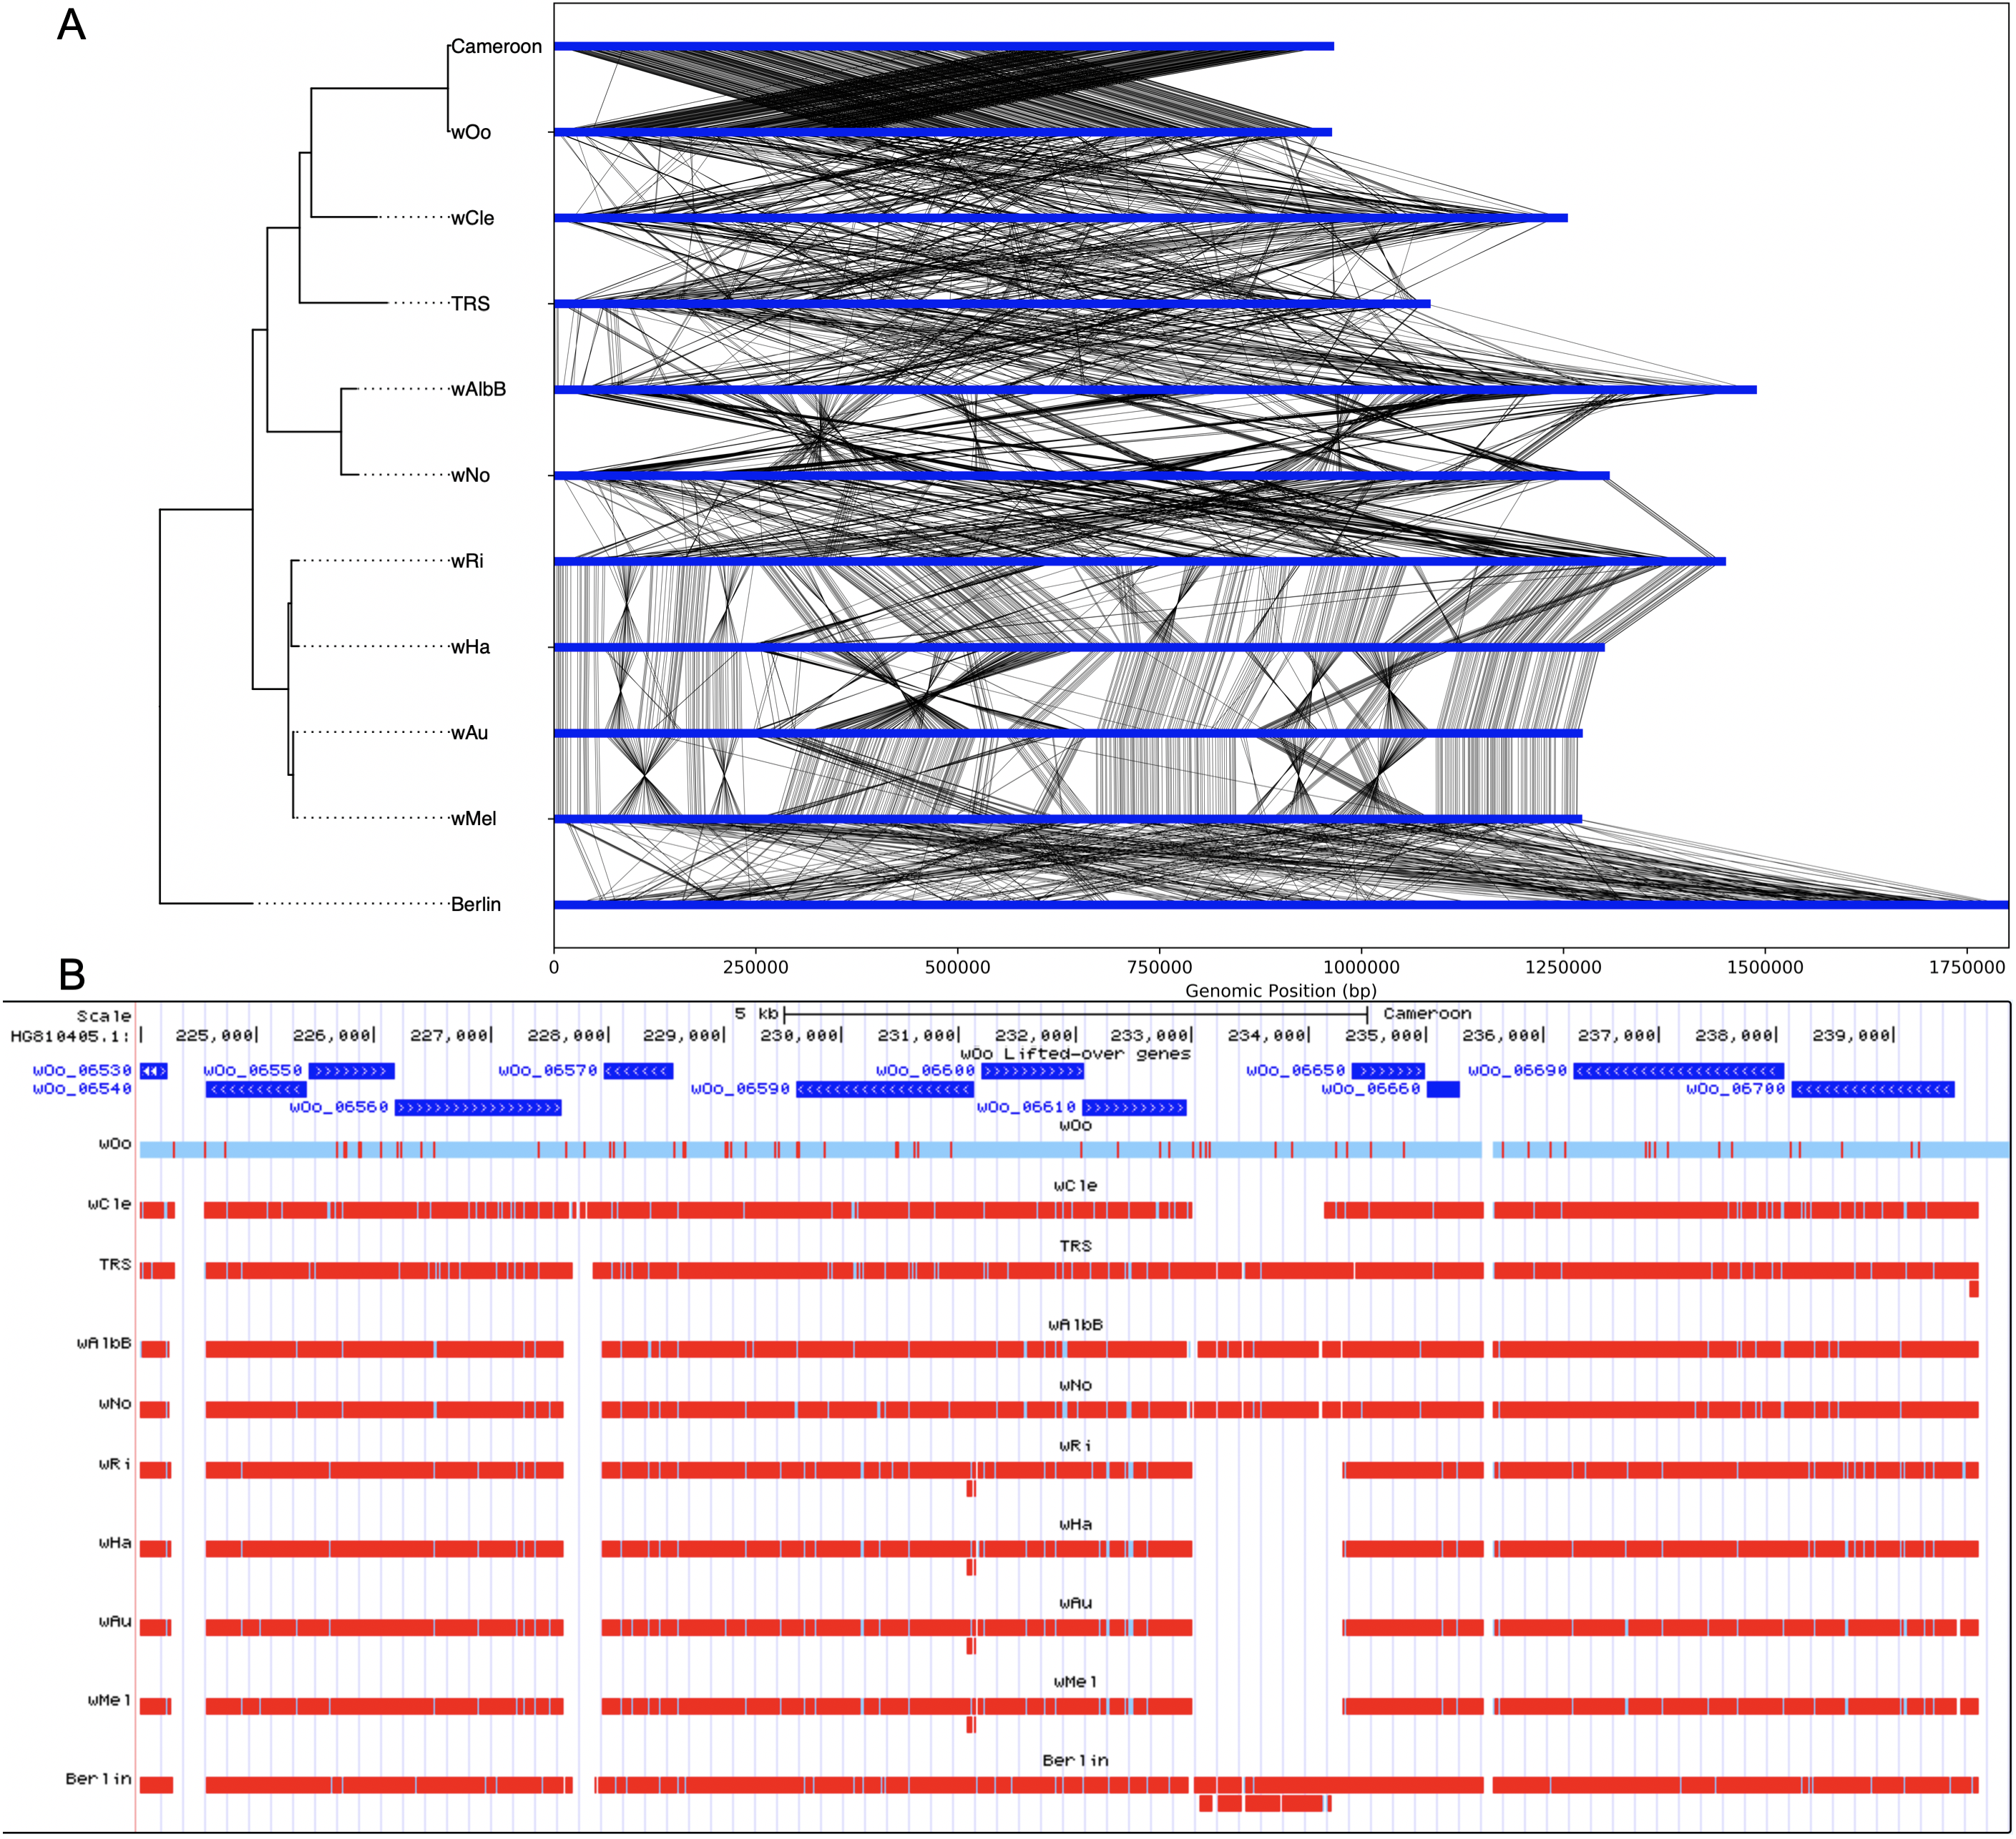
Conserved neighborhoods despite significant rearrangements

Slide 12
Predicting transcriptional units(TU) with RNAseq data
SeqTU (Chou, 2015)
coverage continuity
Coverage variance (between and across)
Support vector machine-based binary classification (co-transcribed, not co-transcribed)
Rockhopper (McClure, 2013)
Intergenic distance
Similarity of gene expression across experiments
Naïve Bayes classifier
Notes:
SeqTU
- Recall (TP/FN) ~ 0.9 (Clostridium thermocellum, 454 verified, E. coli K12)
Rockhopper
Prob of cotranscribed given intergenic distance : distribution of distances between consecutive genes on same strand vs distribution of distances between consecutive genes on opposite strand
Prob of cotrasncribed given expression : correlation of expression between experiments
Naïve Bayes (assumes features are independent ~ naïve assumption)
P(C|x) = P(C)P(x|C) / P(x)

Slide 13
Research Design
Find operons highly supported by RNAseq data in wMel
ModENCODE wMel life cycle, SeqTU, Rockhopper
Determine conserved gene pairs across Wolbachia genome assemblies
Cactus/Blastp to connect orthologs
Provide scores base on how frequently genes are adjacent in same strand
Train operon classifier for classification of operons in Wolbachia genomes
Using RNAseq supported operons as positive set
Adjacent genes in opposite strands used for negative set
Features: Intergenic distance, pair-conservation, intergenic promoters/terminators (PePPER), codon usage similarity (GCUA/COUSIN), similar GO/KEGG functional classification (BLAST2GO,KEGG mapper)

Slide 14
Repeat Evolution
Comprehensive repeat annotations are lacking from most Wolbachia strains
New Wolbachia assemblies allow us to explore repeat content in evolutionary context
Frequent genomic rearrangements observed as well as high repeat counts
Is frequency of genomic rearrangements associated with repeat content in Wolbachia?
Are specific classes of repeats more likely to be involved in genomic rearrangements?
Are their clade specific patterns in repeat content or specific types/families of repeats?

Slide 15
Approach
Determine the best tools for annotating repeat classes
ISEScan: Insertion sequence elements
RepeatScout+ RepeatMasker: General Repeats (Simple repeats, large repeats)
MUMmer (repeat-match) : Exact and exact tandem repeats
Ankyrin repeats: HMMER with ANK HMM from PFAM
Annotate and compare repeats across complete Wolbachia assemblies
Annotate and compare repeats across wMel infections (Illumina)
Reference-based identification of repeat changes
Breseq: Identify INDELs, compare to wMel repeat annotations
PanISa: Non-reference insertion sequence identification

Slide 16
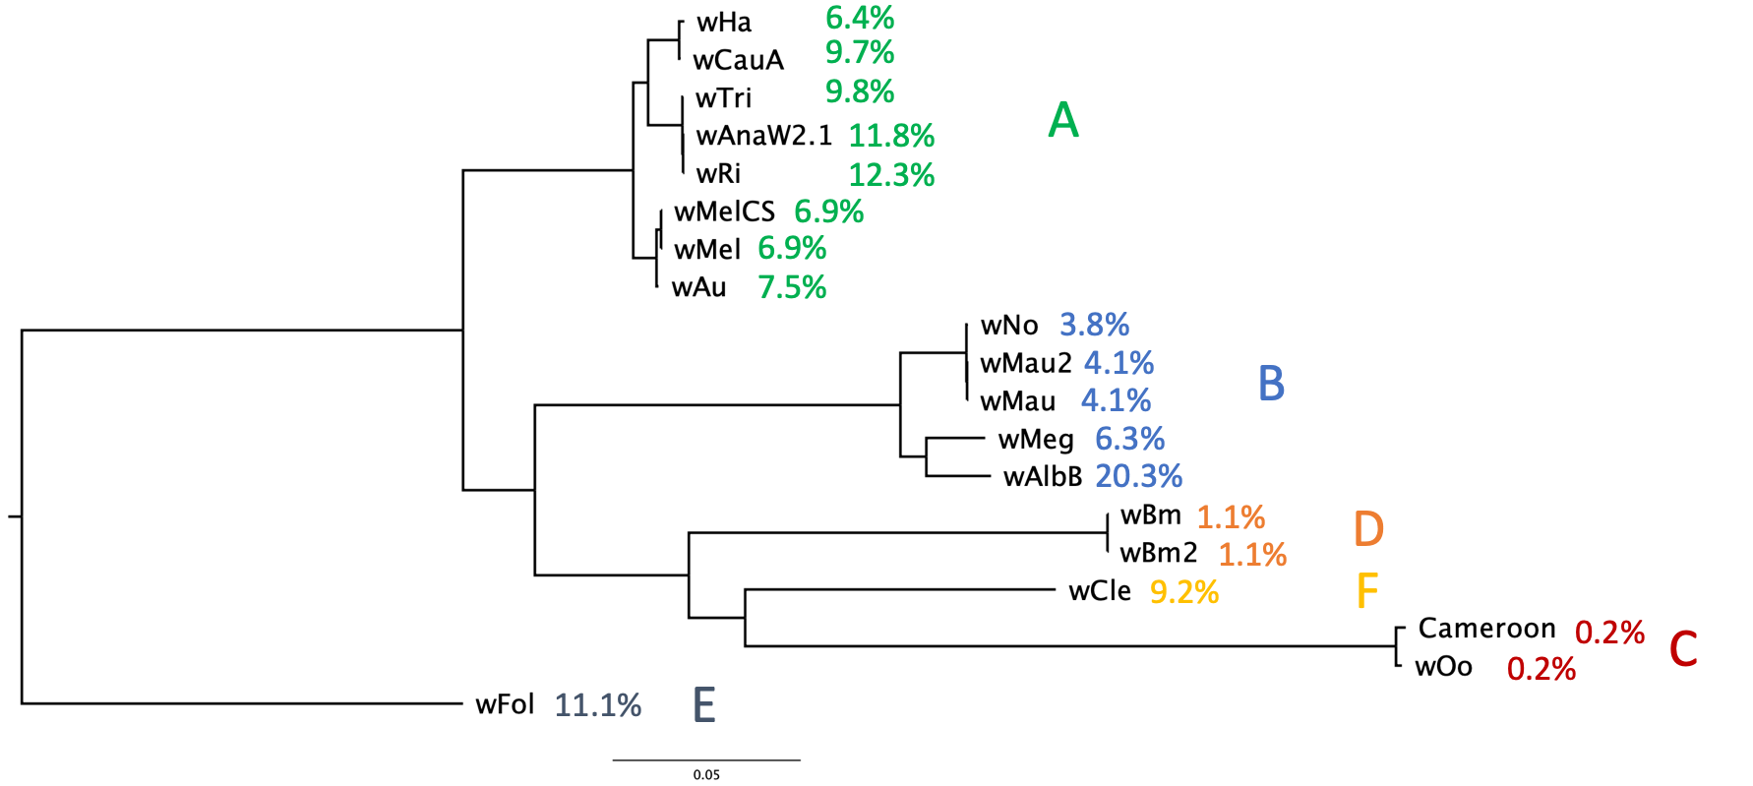
Insertion Sequence Elements in Wolbachia
(ISEScan Predictions)
Host:
Arthropod
Nematode

Slide 17
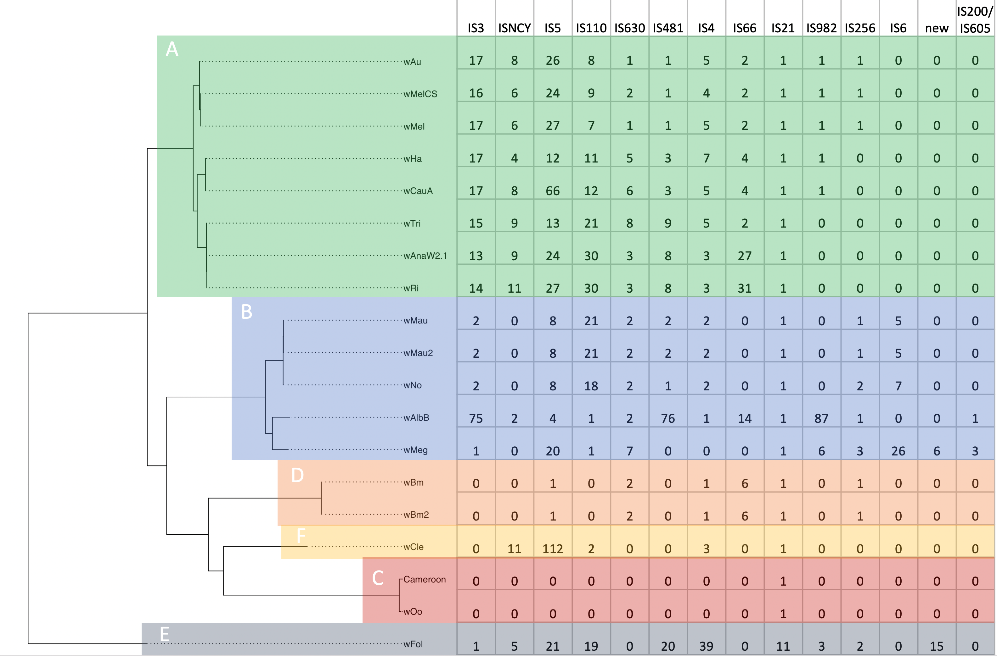

Host:
Arthropod
Nematode
Notes:
IS6 – Supergroup B specific
- most parsimonious explanation – gain of an IS family
- IS6 closest match in BLAST = Cardinium (distantly related(different phylum), co-infects supergroup B hosts)
- preteobacteria vs Cytophaga-Flavobacterium-Bacteroides
wCle – low IS family diversity – high IS content
- Represents lineage likely with an ancestral nematode host (D & C are Nematode infecting, F is a mix of nematode and arthropod infecting strains)
- could show that nematode ancestor lost most IS family diversity
- return to arthropod host resulted in expansion of existing

Slide 18
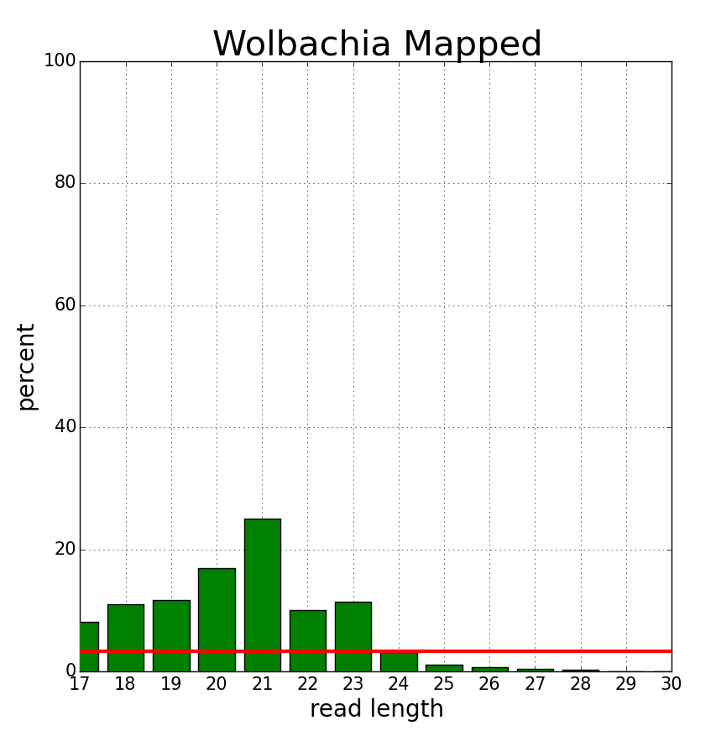
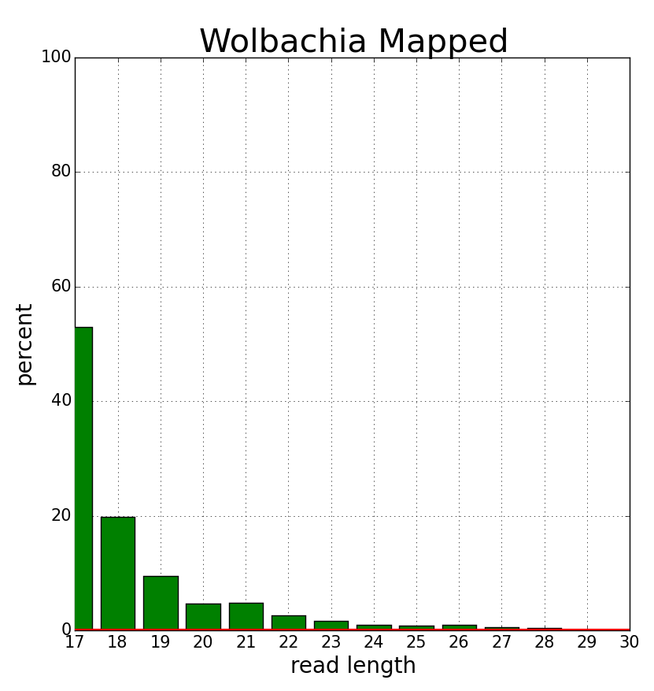
Short RNAs in Wolbachia
Wolbachia-”Positive” Samples
Wolbachia-Negative Samples
Notes:
2-3% of short RNAseq (18-29nt) reads from infected D. melanogaster map to Wolbachia genome
Is this just incorrectly mapping host reads?
Uninfected D. melanogaster have 0.01-0.08% mapping to Wolbachia
Simulated 73,444,616 (10x Dmel coverage) reads and mapped – 0.16% mapped

Slide 19
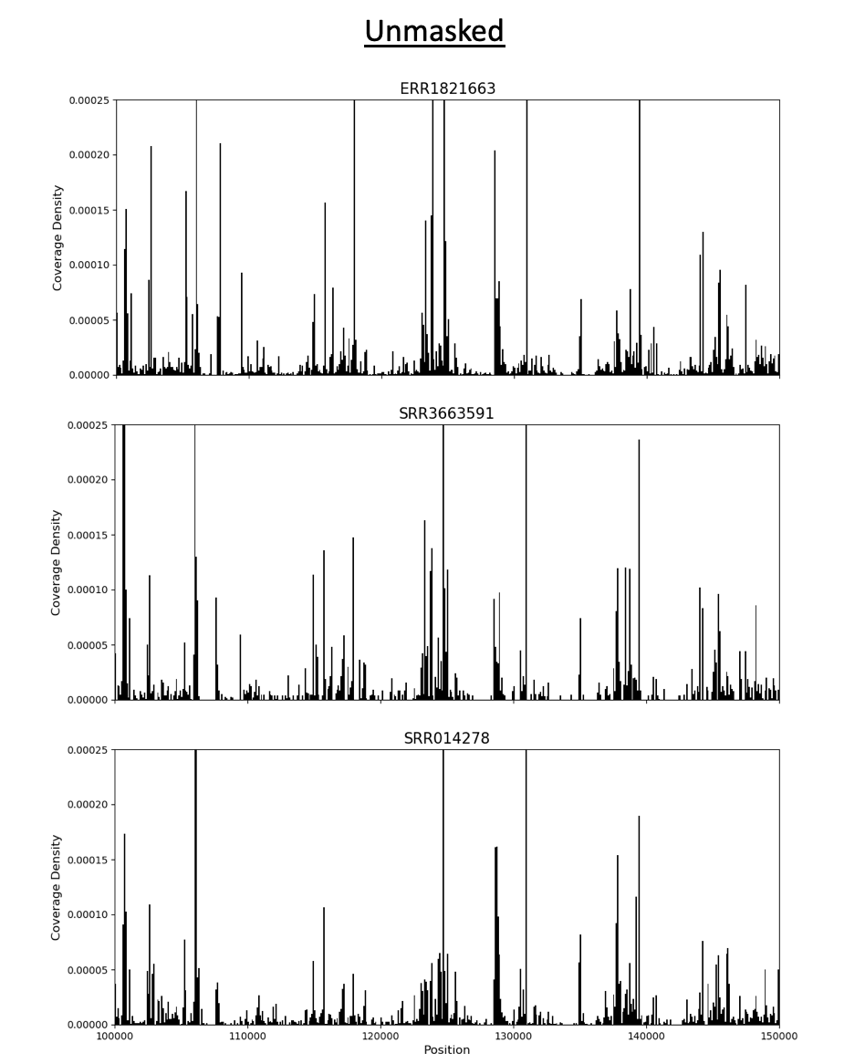
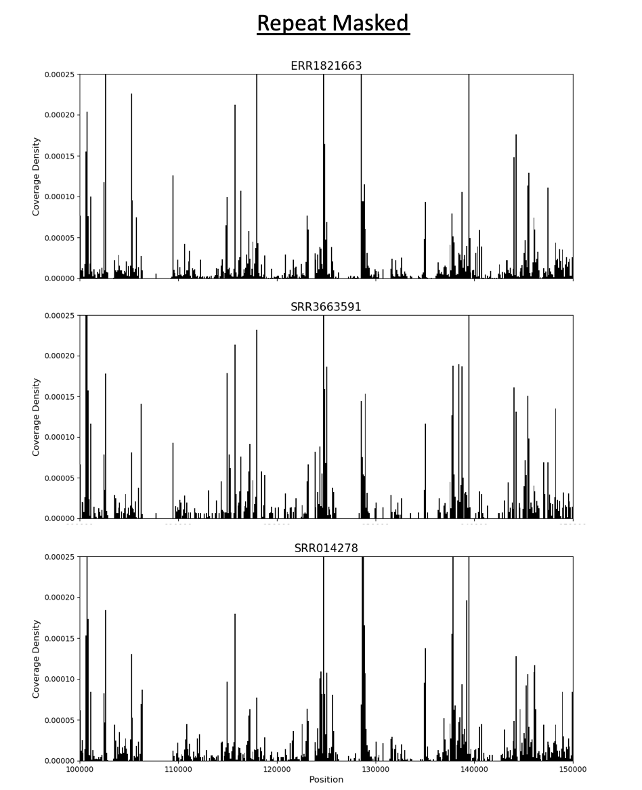
Wolbachia-mapped short RNAs show consistent pattern across samples

Slide 20
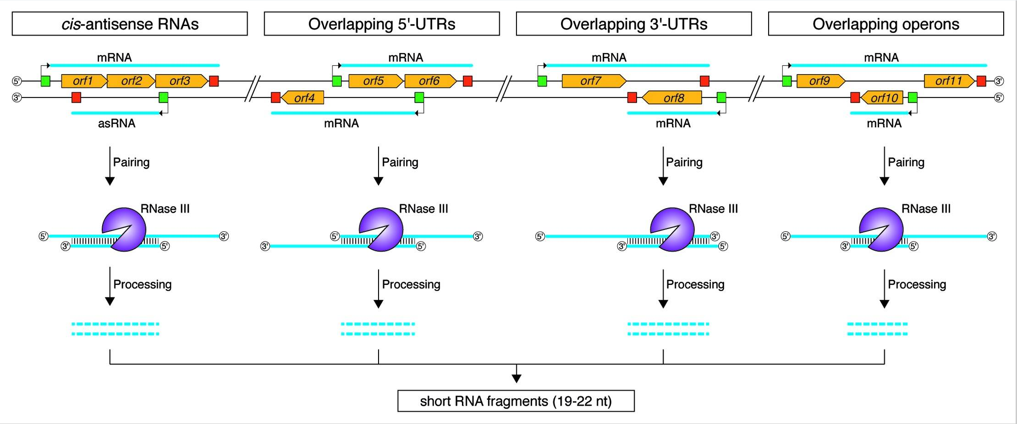
Short-RNAs-Biological Role in Bacteria
(Lasa, 2012)
Notes:
Lasa et al. 2011 – Staphylococcus aureus
Short RNAs could be evidence of Rnase III mediated transcriptional control
Or could be evidence of prevalent transcriptional interference
In AT-rich genomes, higher chance for spurious pribnow box (-10) (TATAAT) motif
- correlation between AT% and sRNAs (Llorens-Rico et at. 2016)

Slide 21
Approach
Identify Wolbachia-infected short RNA projects in NCBI
Map to wMel genome
Annotate regions of antisense transcription in wMel
ModEncode Stranded RNAseq
Annotate ncRNAs in wMel
Rockhopper : novel transcript identification
Determine which genome features correlate with short RNA hotspots
Antisense transcripts, small ncRNAs, repeats
Simulation (are short RNAs mapping to specific features more than expected?)

Slide 22
Conclusion
Wolbachia genomes exhibit unique characteristics
abundant repeats
dynamic gene expression despite few transcription factors
Short RNAs
Build enhanced framework for future studies in Wolbachia
Provide insights into Wolbachia evolution in intracellular environment
Host-endosymbiont interactions

